Slide 1

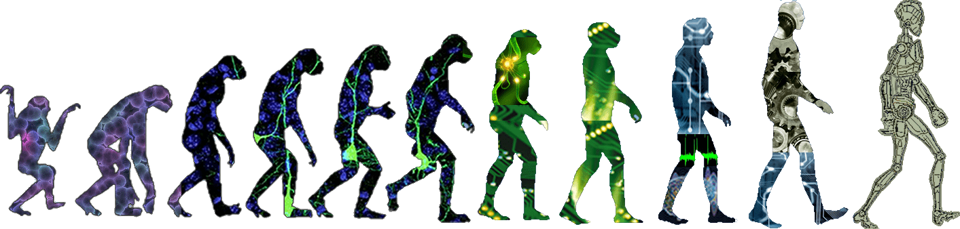
Autonomous Coupling of a UAV and UGV Technical Presentation and Interview for SpaceX Design Criteria Engineer (Vehicle Engineering) Undergraduate Honors Thesis by Chris Breaux Supervised by Dr. Panagiotis Artemiadis
Notes:
Breathe

Slide 2
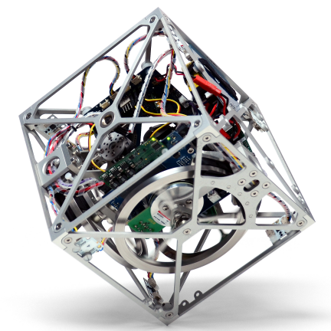
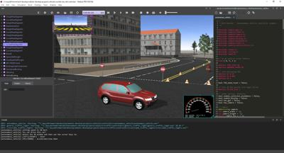
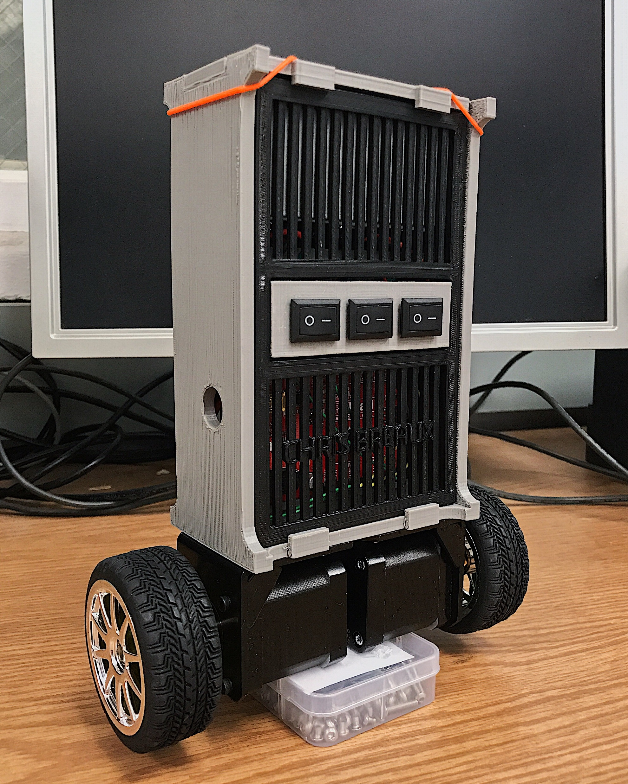
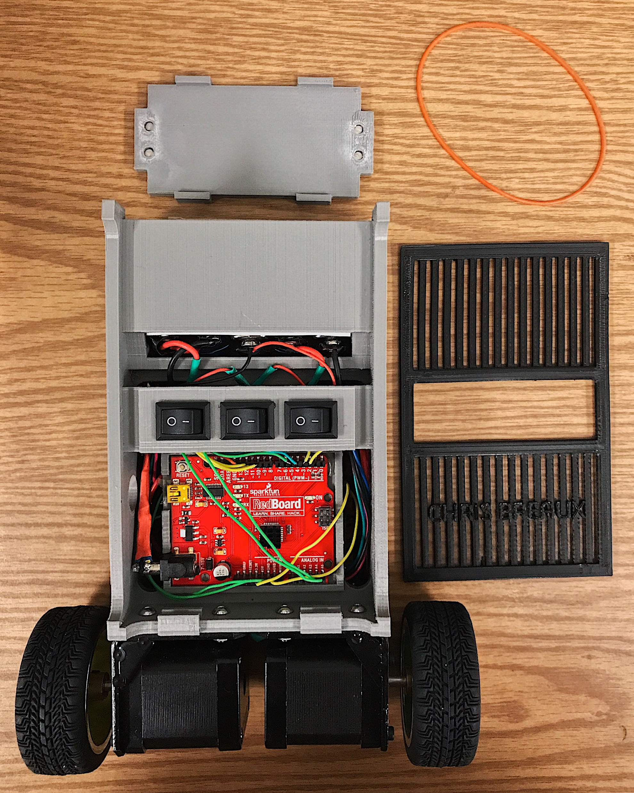
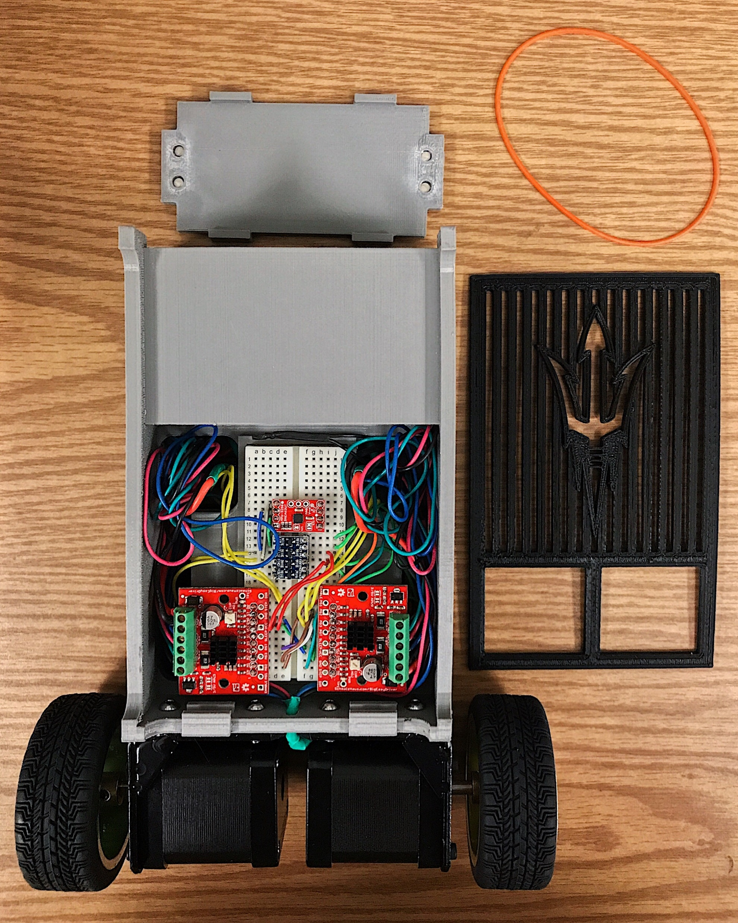
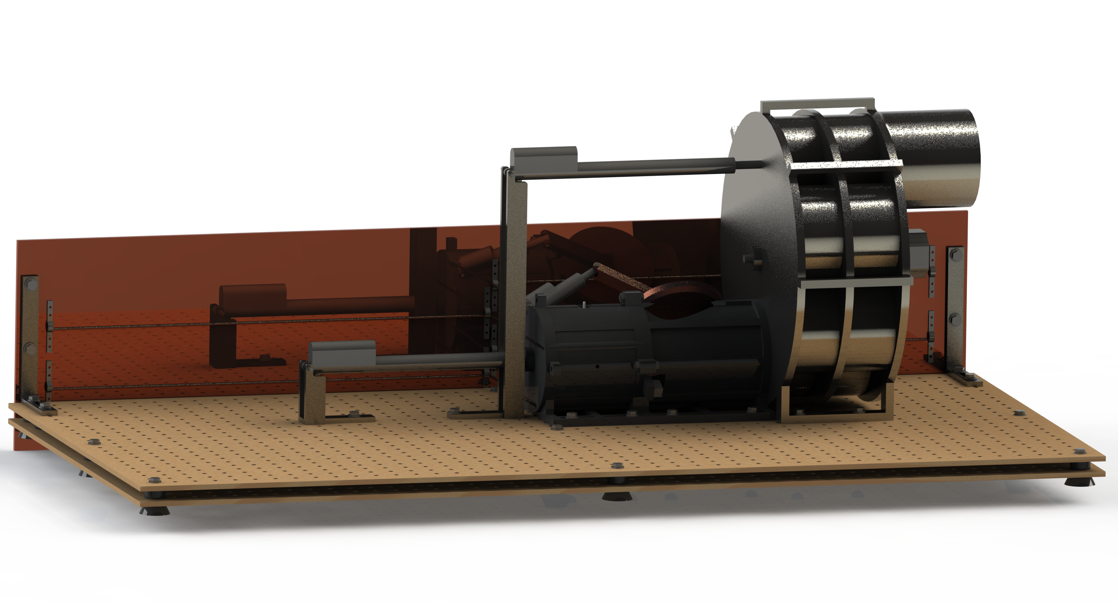
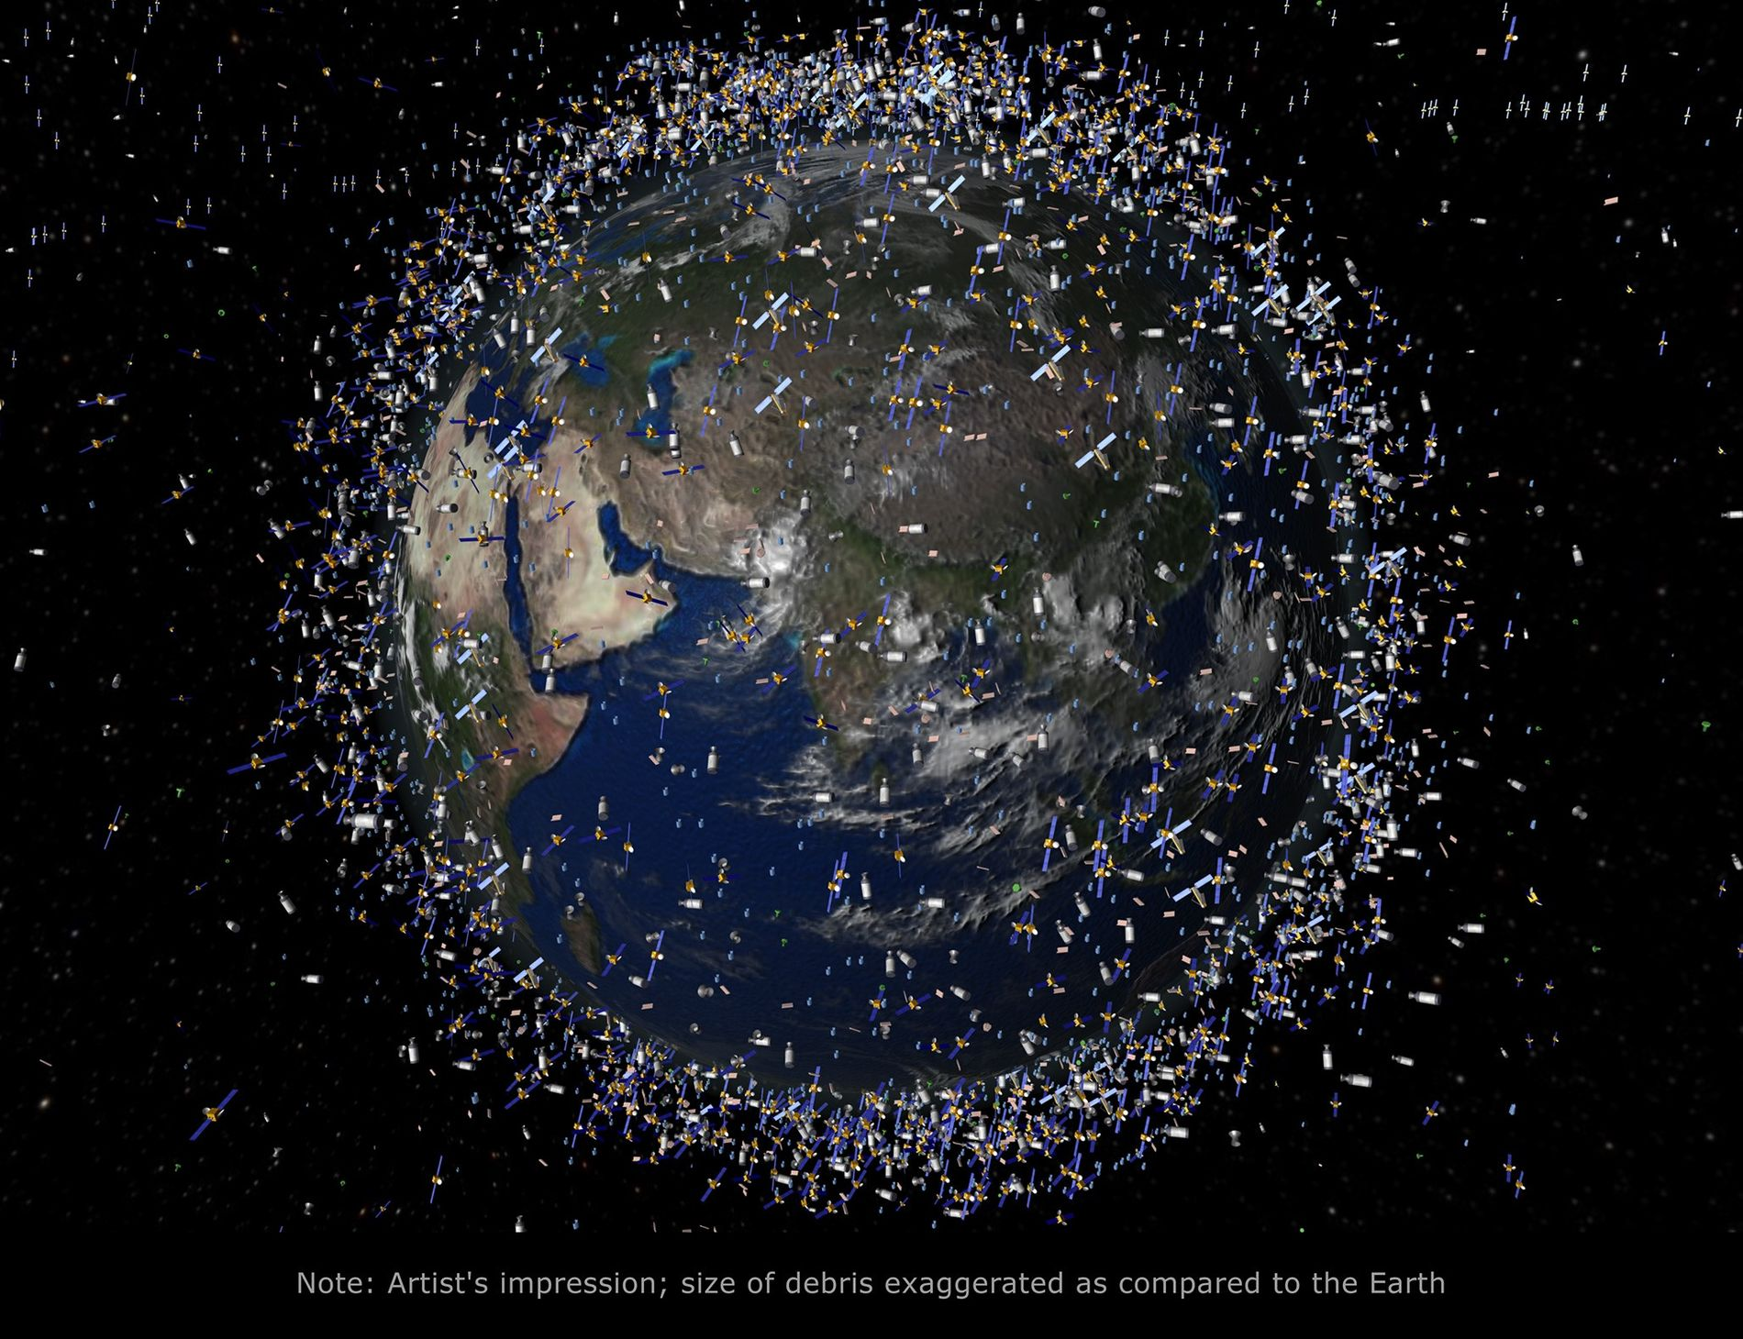
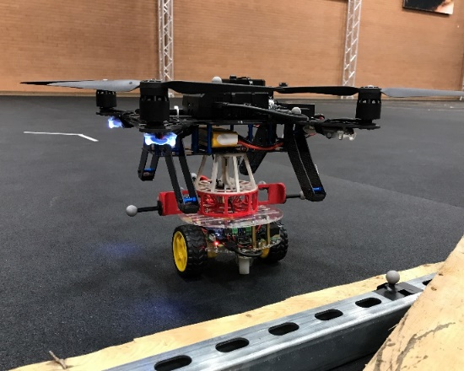
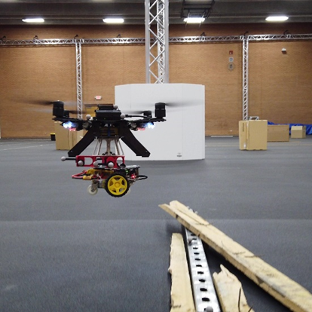
Background
Numerical Simulator for Lunar Tumbling Robot
Satellite Solution for Harmful Orbital Targets
Two-Wheel Self-Balancing Robot
Autonomous Coupling of a UAV and UGV
Notes:
Education Background
Mechanical Engineering BSE (Grad May 2020)
Robotics and Autonomous Systems (Mechanical Engineering) MS (Grad May 2021)
Project background
I like this project because it required such a wide variety of skills
I had to self teach most of what I used because this was before I took any robotics classes, and I had no prior experience with Linux or python
It was fun

Slide 3
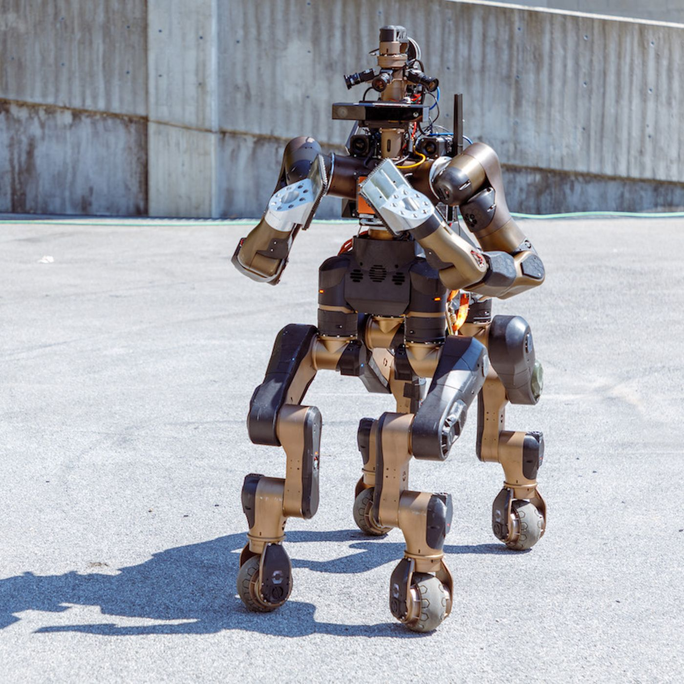
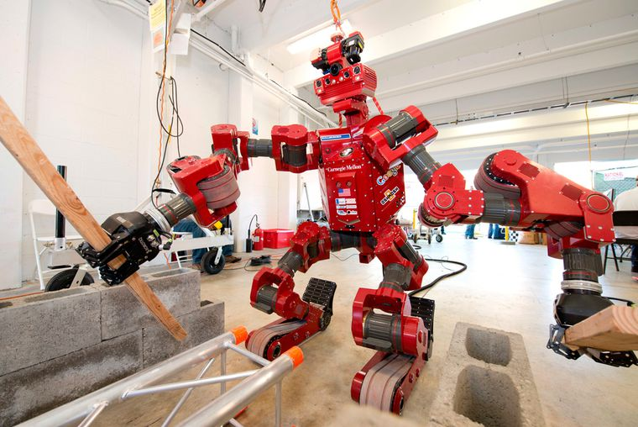
Motivation
In search and rescue missions, complex robots may compromise their performance in some tasks to accommodate a greater set of tasks.
A heterogeneous team of simple robots can maximize their strengths while complementing each other’s weaknesses.
These simple robots can achieve more working together than they could on their own but cost less than a single robot with the same combination of capabilities.

Slide 4
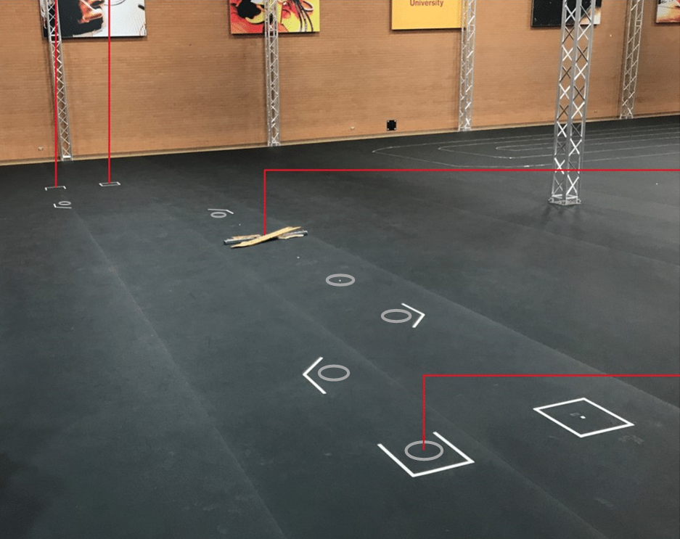
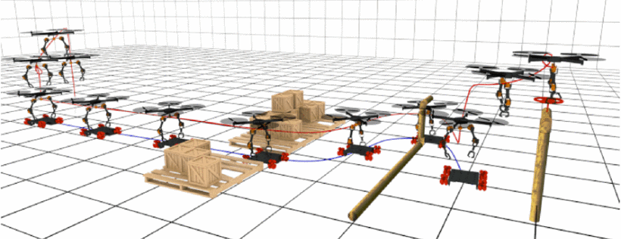
Objective
Validate a symbiotic UAV and UGV relationship with a hardware experiment.
The team must be capable of the following:
The UGV must navigate a space while the UAV follows.
The UAV must couple with the UGV.
The UAV must lift the UGV over an obstacle.
The UGV must navigate the space while carrying the UAV.
Notes:
UAV strength
High maneuverability
High scope
UAV weakness
Low payload capacity
Low range
UGV strength
High payload capacity
High range
UGV weakness
Low mobility
Low field of view
Complement each other - find a way to share

Slide 5
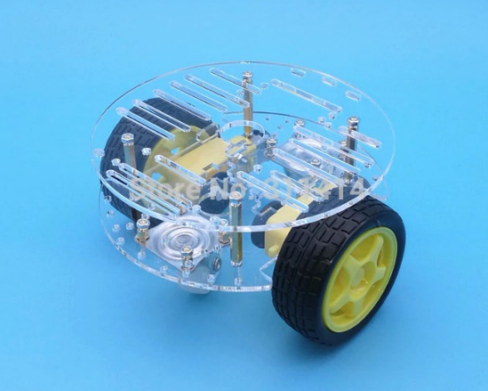
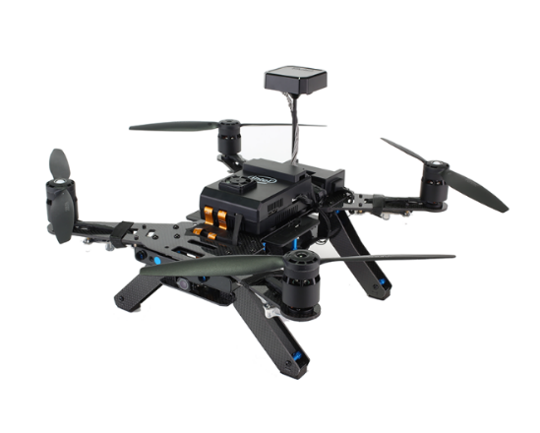
Robot Selection
UGV Requirements:
Mass < UAV payload capacity
Maneuverable in a hallway
Stable landing platform
UAV Requirements:
Payload > UGV mass
Maneuverable in a hallway
Two-Wheel Drive UGV:
Acrylic Chassis
140-millimeter diameter
330 grams
Four points of contact with the ground
Intel Aero Quadrotor UAV:
Open frame
360-millimeter diagonal hub-to-hub length
1-kilogram payload
Figure 2: 2WD UGV Platform
Figure 3: Intel Aero UAV Platform
Notes:
The selection of robots primarily depends on the weight of the UGV and the payload capacity of the UAV.
UGV
Raspberry Pi
Motor HAT
Ubuntu MATE 16.04 operating system
ROS Kinetic
Adafruit_MotorHAT library
Laptop
Ubuntu 16.04 operating system
QGroundControl
UAV
Intel Aero Compute Board
Intel Aero Flight Controller
Ubuntu 16.04 operating system
ROS Kinetic
vrpn_client_ros package
mavros package
PX4 Autopilot
LPE position estimator

Slide 6
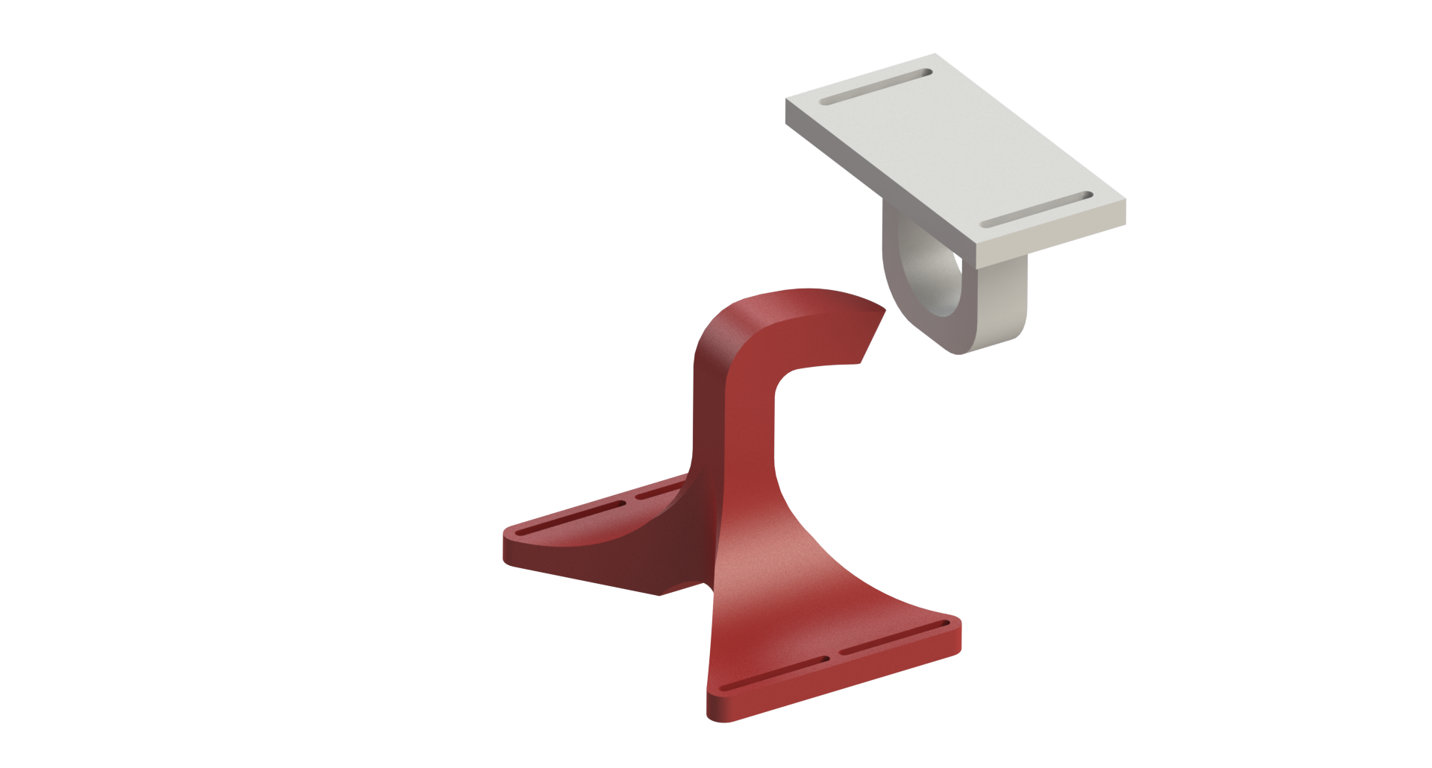
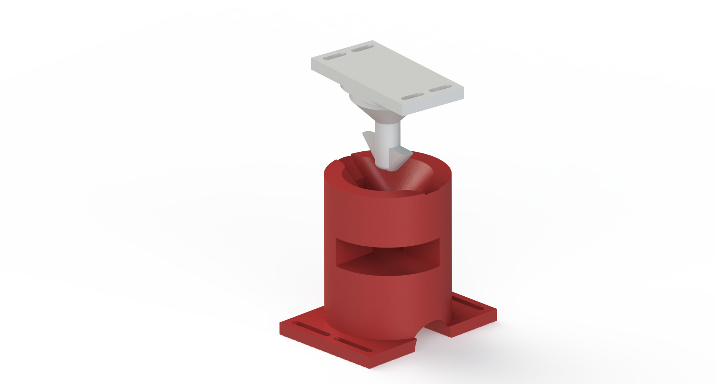
Coupling Mechanism Design Requirements
Primary Design Requirements:
The UAV must lift the UGV and remain coupled during flight.
The UGV must carry the UAV and remain coupled while driving.
Secondary Design Requirements:
The coupling mechanism must capture the robots’ resolution of control
The coupling mechanism must prevent crashing in case of coupling failure
The coupling mechanism must limit physical interactions before coupling
The coupling mechanism must avoid interference with landing gear and propellers
The coupling mechanism must remain coupled if UAV loses power
The coupling maneuver must preserve the orientation outputs of the robots
The coupled configuration must not affect the flying and driving dynamics
The holding force must be greater than the UAV’s maximum acceleration

Slide 7
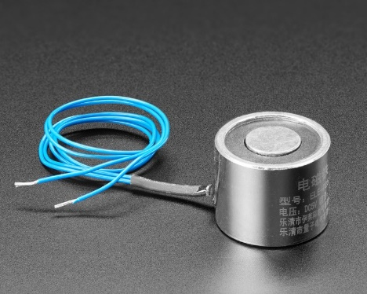
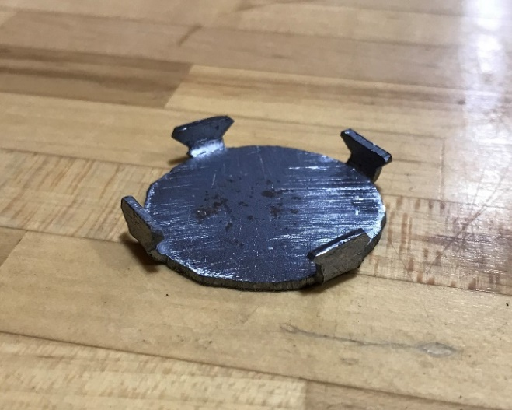
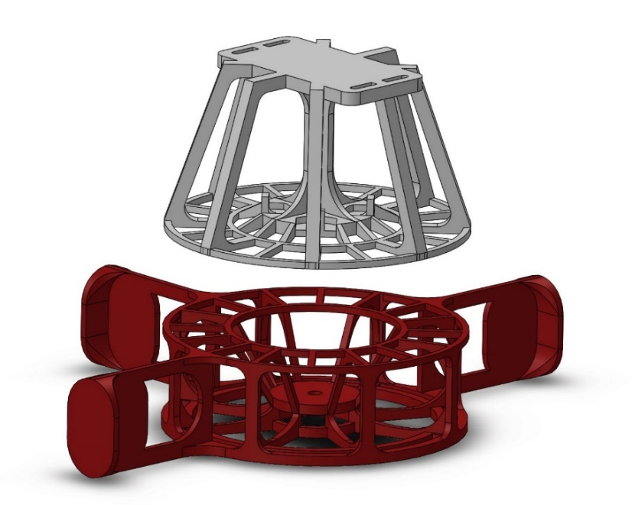
Coupling Mechanism Design
UGV powers an electromagnet
Instant
Guiding forces without contact
UAV attaches with a steel plate
No residual pull
Slots adjusts to the center of mass
Wide 90-millimeter circular ring
Captures UAV’s resolution of control
prevents opening mode separation
Holds the UGV even completely sideways
Twisting friction
Enables vertical descent maneuver
Preserves orientation outputs
Figure 4: EM Interface (Red) and FM Interface (White)
Notes:
Evolved a lot as I was testing different stages of the control and discovered new failure modes
Ferromagnet interface attaches a steel plate to the UAV.
Electromagnet interface attaches an electromagnet to the UGV.
The vertical descent preserves the other control outputs of the UAV.
Guiding forces account for control errors.
The process to engage and disengage the coupling mechanism occurs instantaneously.
Coupling Maneuver
UAV matches the UGV’s stationary ground position.
UGV engages the electromagnet.
UAV descends towards the UGV.
Electromagnetic forces guide the interfaces to the coupled position.
Decoupling Maneuver
UAV lands.
UGV disengages the electromagnet.
Electromagnet
5 kilogram holding force
0.3 amp draw at 5 volts
20 millimeters tall
25-millimeter diameter
Compatible with Raspberry Pi
Steel Plate
No residual pull
35-millimeter diameter

Slide 8
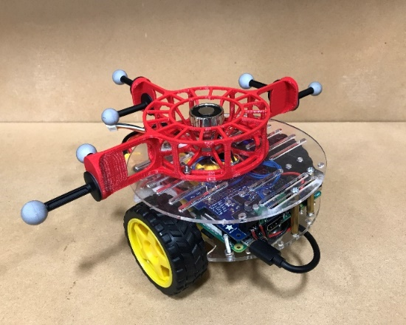
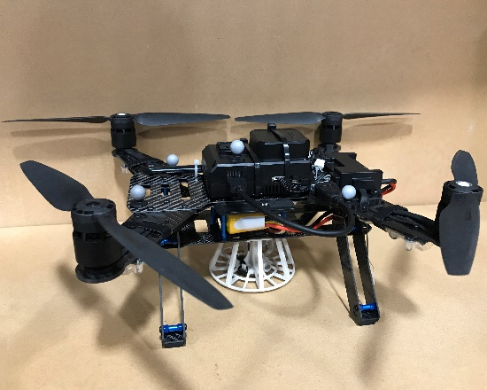
Final Assembly
Total mechanism height: 8 centimeters
UGV mass: 639 grams
UAV mass: 1015 grams
Combined mass: 1654 grams
246 grams below the maximum takeoff weight
87% of the maximum takeoff weight
159% increase in driving load
63% increase in flying load
Figure 10: UGV Final Assembly
Figure 12: UAV Final Assembly
Figure 14: Coupled System Final Assembly
Notes:
The EM interface was 3D printed.
The EM interface is mounted over the UGV’s center of mass.
Tracking markers are mounted to the wings.
The FM interface was 3D printed.
UGV’s tracking markers extend beyond the landing gear of the UAV.
The landing gear of the UAV does not interfere with the coupling mechanism.
Both mechanisms are aligned with the robot’s center of mass

Slide 9
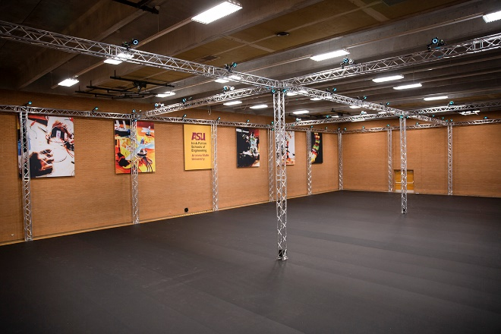
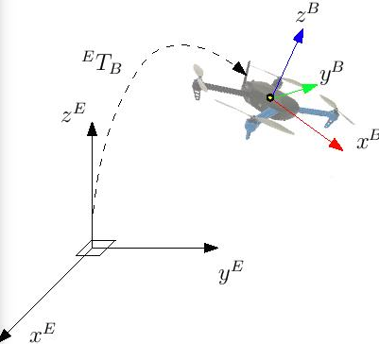
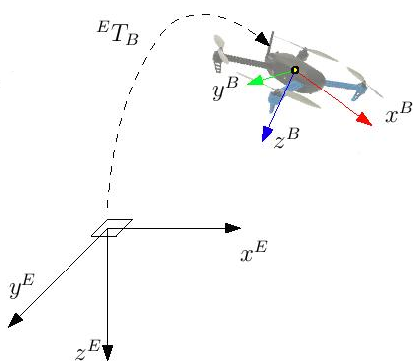
Localization
Motion Capture space tracks beacons
< 1 millimeter position
< 1° in orientation.
Desktop publishes FLU/ENU pose data to shared Wi-Fi network
The UGV uses FLU/ENU frame for its controls.
Mavros plugin performs transformation to FRD/NED and relays it to the PX4 flight controller.
UAV uses FRD/NED frame for its controls.
Figure 7: Motion Capture Space
Figure 8: FLU/ENU
Figure 9: FRD/NED
Notes:
The UAV launches roscore and the vrpn_client_node which subscribes to the tracked objects published by the desktop.
The UGV communicates with the ROS master running on the UAV to receive the pose topics.
ROS Output:
Forward-Left-Up local frame
East-North-Up world frame
The UGV uses this frame of reference for its controls.
PX4 Input:
Forward-Right-Down local frame
North-East-Down world frame
The UAV uses this frame of reference for its controls.
VRPN client remaps the pose topic to /mavros/mocap/pose.
A mavros performs the transformation and relays it to the PX4.

Slide 10
Experiment
The motion capture space isolates the performance of the hardware.
Course is defined by six waypoints interrupted by an obstacle.
Two uncoupled turns
Coupling maneuver
Lift over an obstacle
Two coupled turns
UGV Initial Position
UAV Initial Position
Obstacle
Coupled Final Position
Figure 15: Experimental Test Bed
Notes:
Objective: Assess the capabilities of the robots according to the performance requirements described in the problem statement.
The UGV must navigate a space while the UAV follows.
The UAV must couple with the UGV.
The UAV must lift the UGV over an obstacle.
The UGV must navigate the space while carrying the UAV.
The controlled environment limits disturbances to the system.
The tracking capabilities provide accurate localization.
The motion capture space can also store the tracking data for analysis.

Slide 11
Autonomous Controller Design
UGV 2D Waypoint Control
P velocity control drives at a constant velocity but slows near waypoints
PD differential control steers measured steering angle to desired steering angle
UAV 3D Waypoint Control
PID position control
Proximity threshold
Delay
ROS Topics:
UAV pose, UGV pose, obstacle pose, fly mode, drive mode
Modes and Procedures
Standby
Drive
Engage
Lifting
Disengage
Resting
Notes:
BE SUPER GENERAL THEN GO INTO MORE DETAIL IN THE RESULTS SECTION
The UGV begins in “standby” mode and continually evaluates the distance to the UAV, to the waypoint, and to the obstacle.
When the UAV is within 10 centimeters of the UGV, the UGV switches to “drive” mode.
When the UGV is within 7 centimeters of a waypoint, it targets the next waypoint.
When the UGV is within 30 centimeters of the obstacle, it switches to “engage” mode.
During engage mode, the UGV receives instructions from the UAV via fly mode updates.
The UGV activates the electromagnet.
The UAV subscribes to: UGV pose, UAV pose, obstacle pose
The UAV takes off and continually evaluates the UGV’s distance to the obstacle.
While the UGV drives, the UAV matches the UGV’s ground position with 10-centimeter accuracy.
When the UGV reaches the obstacle, the UAV saves the UGV’s stationary ground position and updates its fly mode to begin the coupling procedure.
The UAV targets waypoints over the coupling position with decreasing altitude and increasing accuracy until it reaches the coupling position.
The UAV targets a waypoint 0.6 meters above the coupling position with 20-centimeter accuracy to take off.
The UAV targets a waypoint on the far side of the obstacle, and one more waypoint in the landed position.
When the UAV lands, it waits 1 second to settle, updates the fly mode to decouple, waits 1 second for the electromagnet to disengage, then takes off again.
Once in the air, the UAV updates the fly mode, and continues following the UGV. At the third waypoint, the robots couple again.
Instead of lifting, the UAV updates the fly mode indicating a “resting” state and disarms its motors while the UGV carries it through the last two turns and stops at the final position.

Slide 12
Video

Slide 13
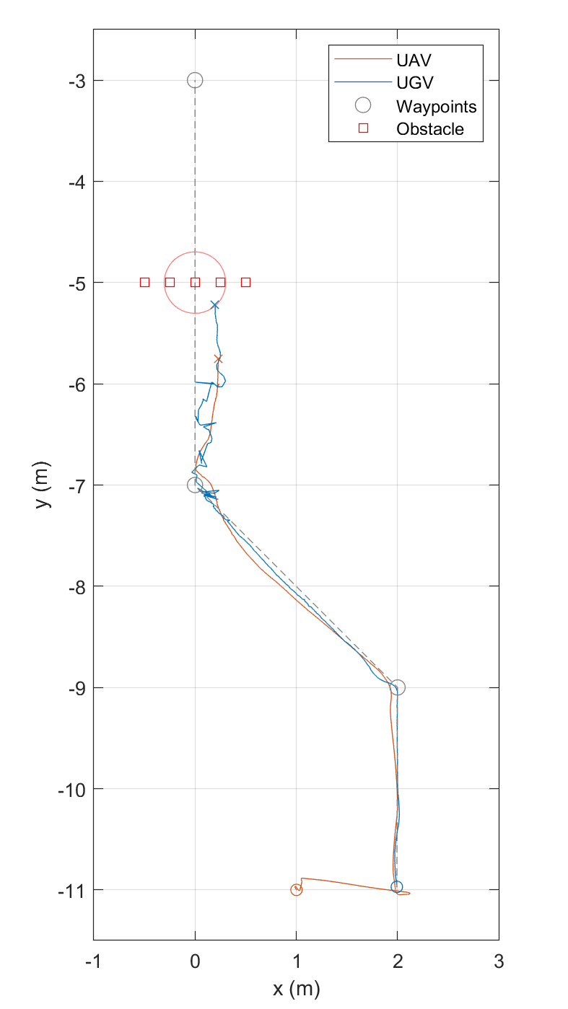
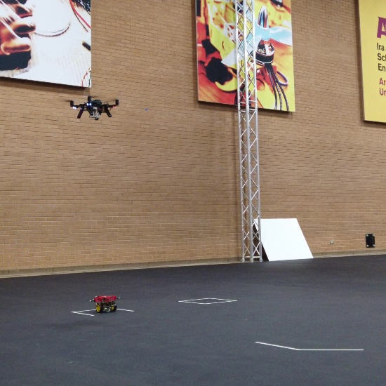
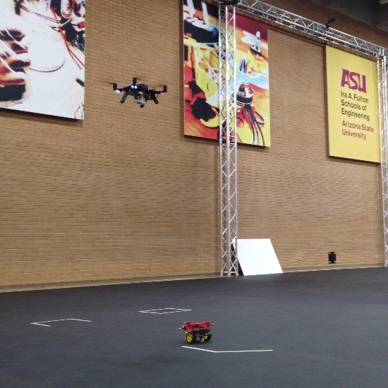
Following
Objective: Decoupled driving and flying through two 45-degree turns
Start: UAV takes off
End: UGV reaches the obstacle
Top view projected onto x-y plane
UGV targeted waypoints with minimal overshoot and settling time
UAV followed UGV through both 45-degree turns
UAV trailed ~1s and ~0.5 behind the UGV
Figure 17: Start Position
Figure 18: UAV Following UGV
Figure 16: Following Phase Tracking Map

Slide 14
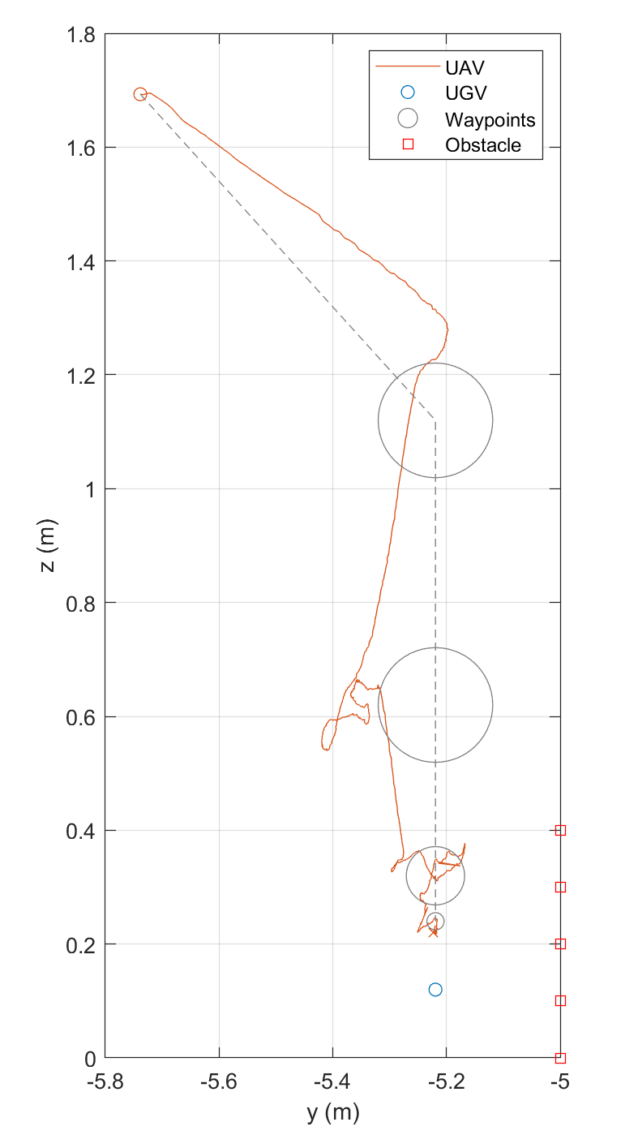
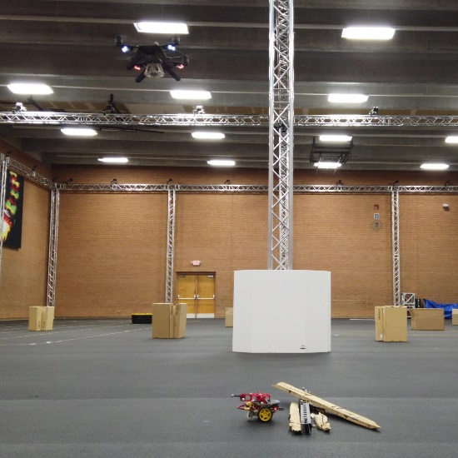
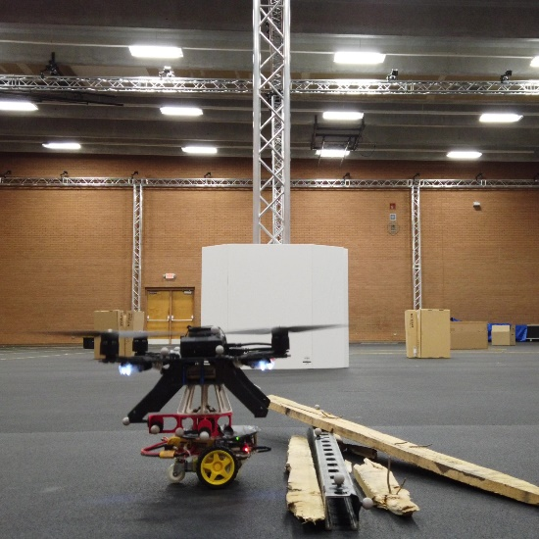
Coupling
Objective: UAV performs coupling maneuver with stationary UGV
Start: UGV reaches obstacle
End: Robots are coupled
Side view projected onto y-z plane
UAV targeted waypoints with minimal overshoot
Overshoot and error decreased as the accuracy increased
UAV met UGV at the coupling position
Figure 20: Initial Position
Figure 21: Coupled Position
Figure 19: Coupling Phase Tracking Map

Slide 15
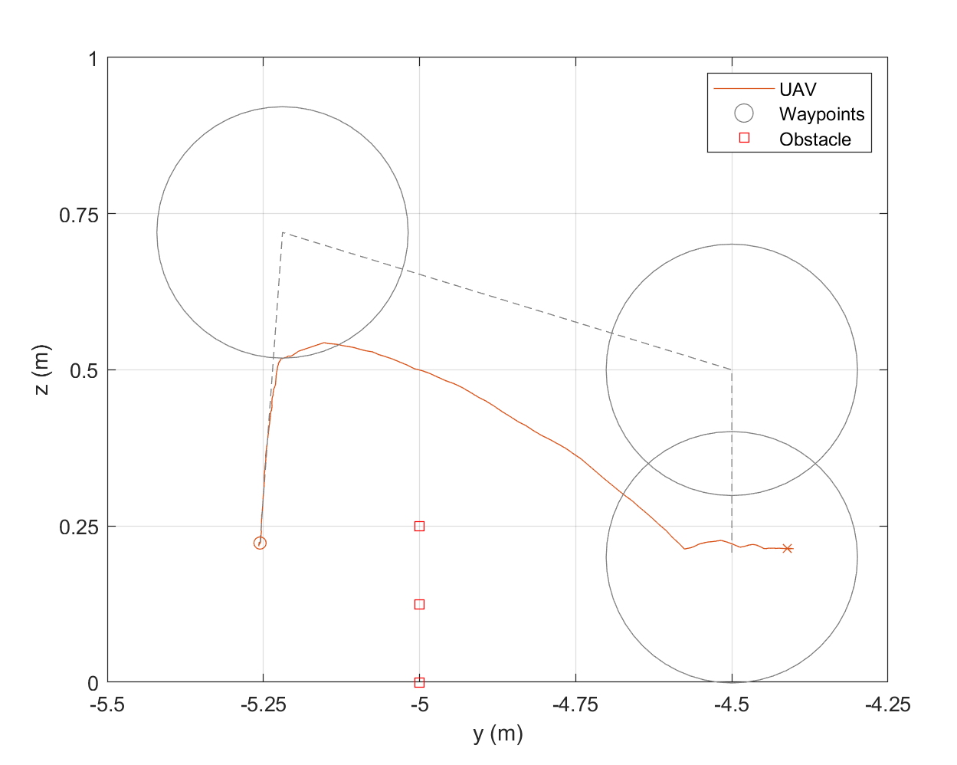
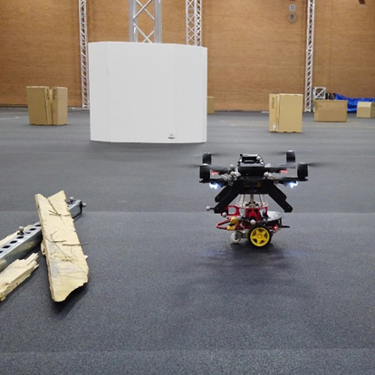
Lifting
Objective: UAV lifts UGV over obstacle
Start: UAV takes off
End: UAV lands
Side view projected onto y-z plane
UAV lifted UGV to first waypoint
UAV rolled too much and lost elevation
UAV still landed on the other side
Figure 23: UAV Lifting UGV
Figure 22: Lifting Phase Tracking Map
Figure 24: Landed Position

Slide 16
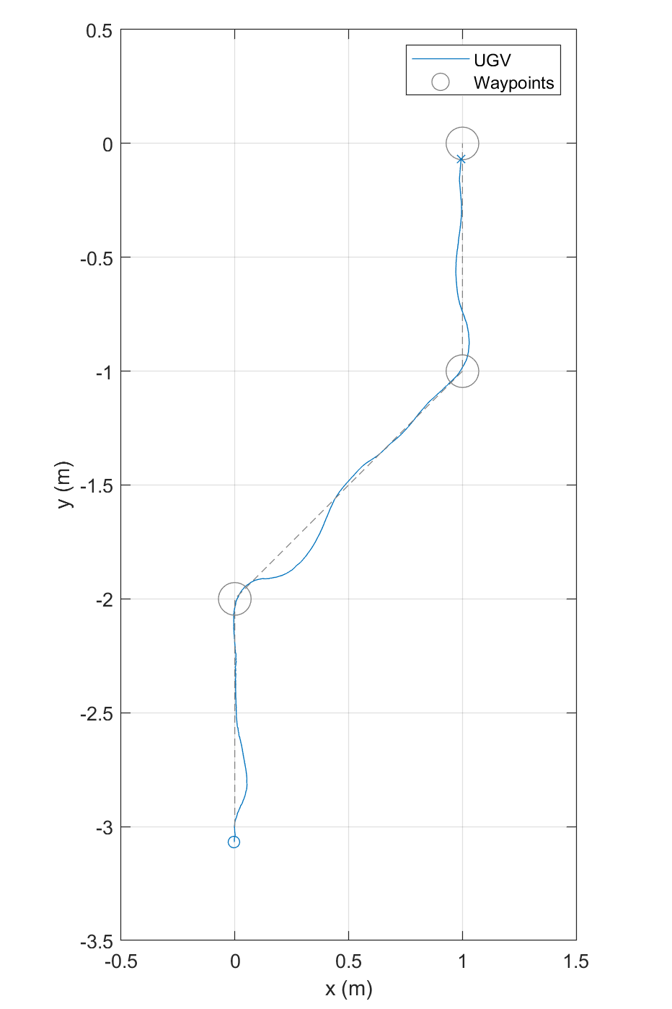
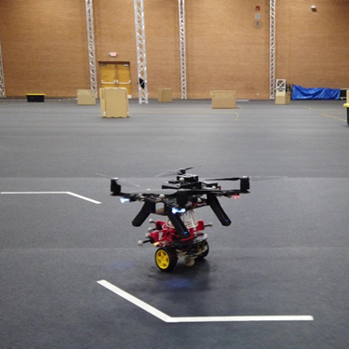
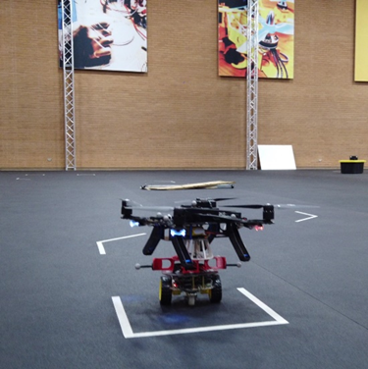
Resting
Objective: Coupled driving through two 45-degree turns
Start: UGV begins driving
End: UGV reaches final waypoint
Top view projected onto x-y plane
UGV targeted waypoints with greater overshoot and settling time than uncoupled driving
UGV drove at approximately the same speed
UGV carried UAV through both 45-degree turns
Figure 26: UGV Carrying UAV
Figure 25: Resting Phase Tracking Map
Figure 27: Final Position

Slide 17
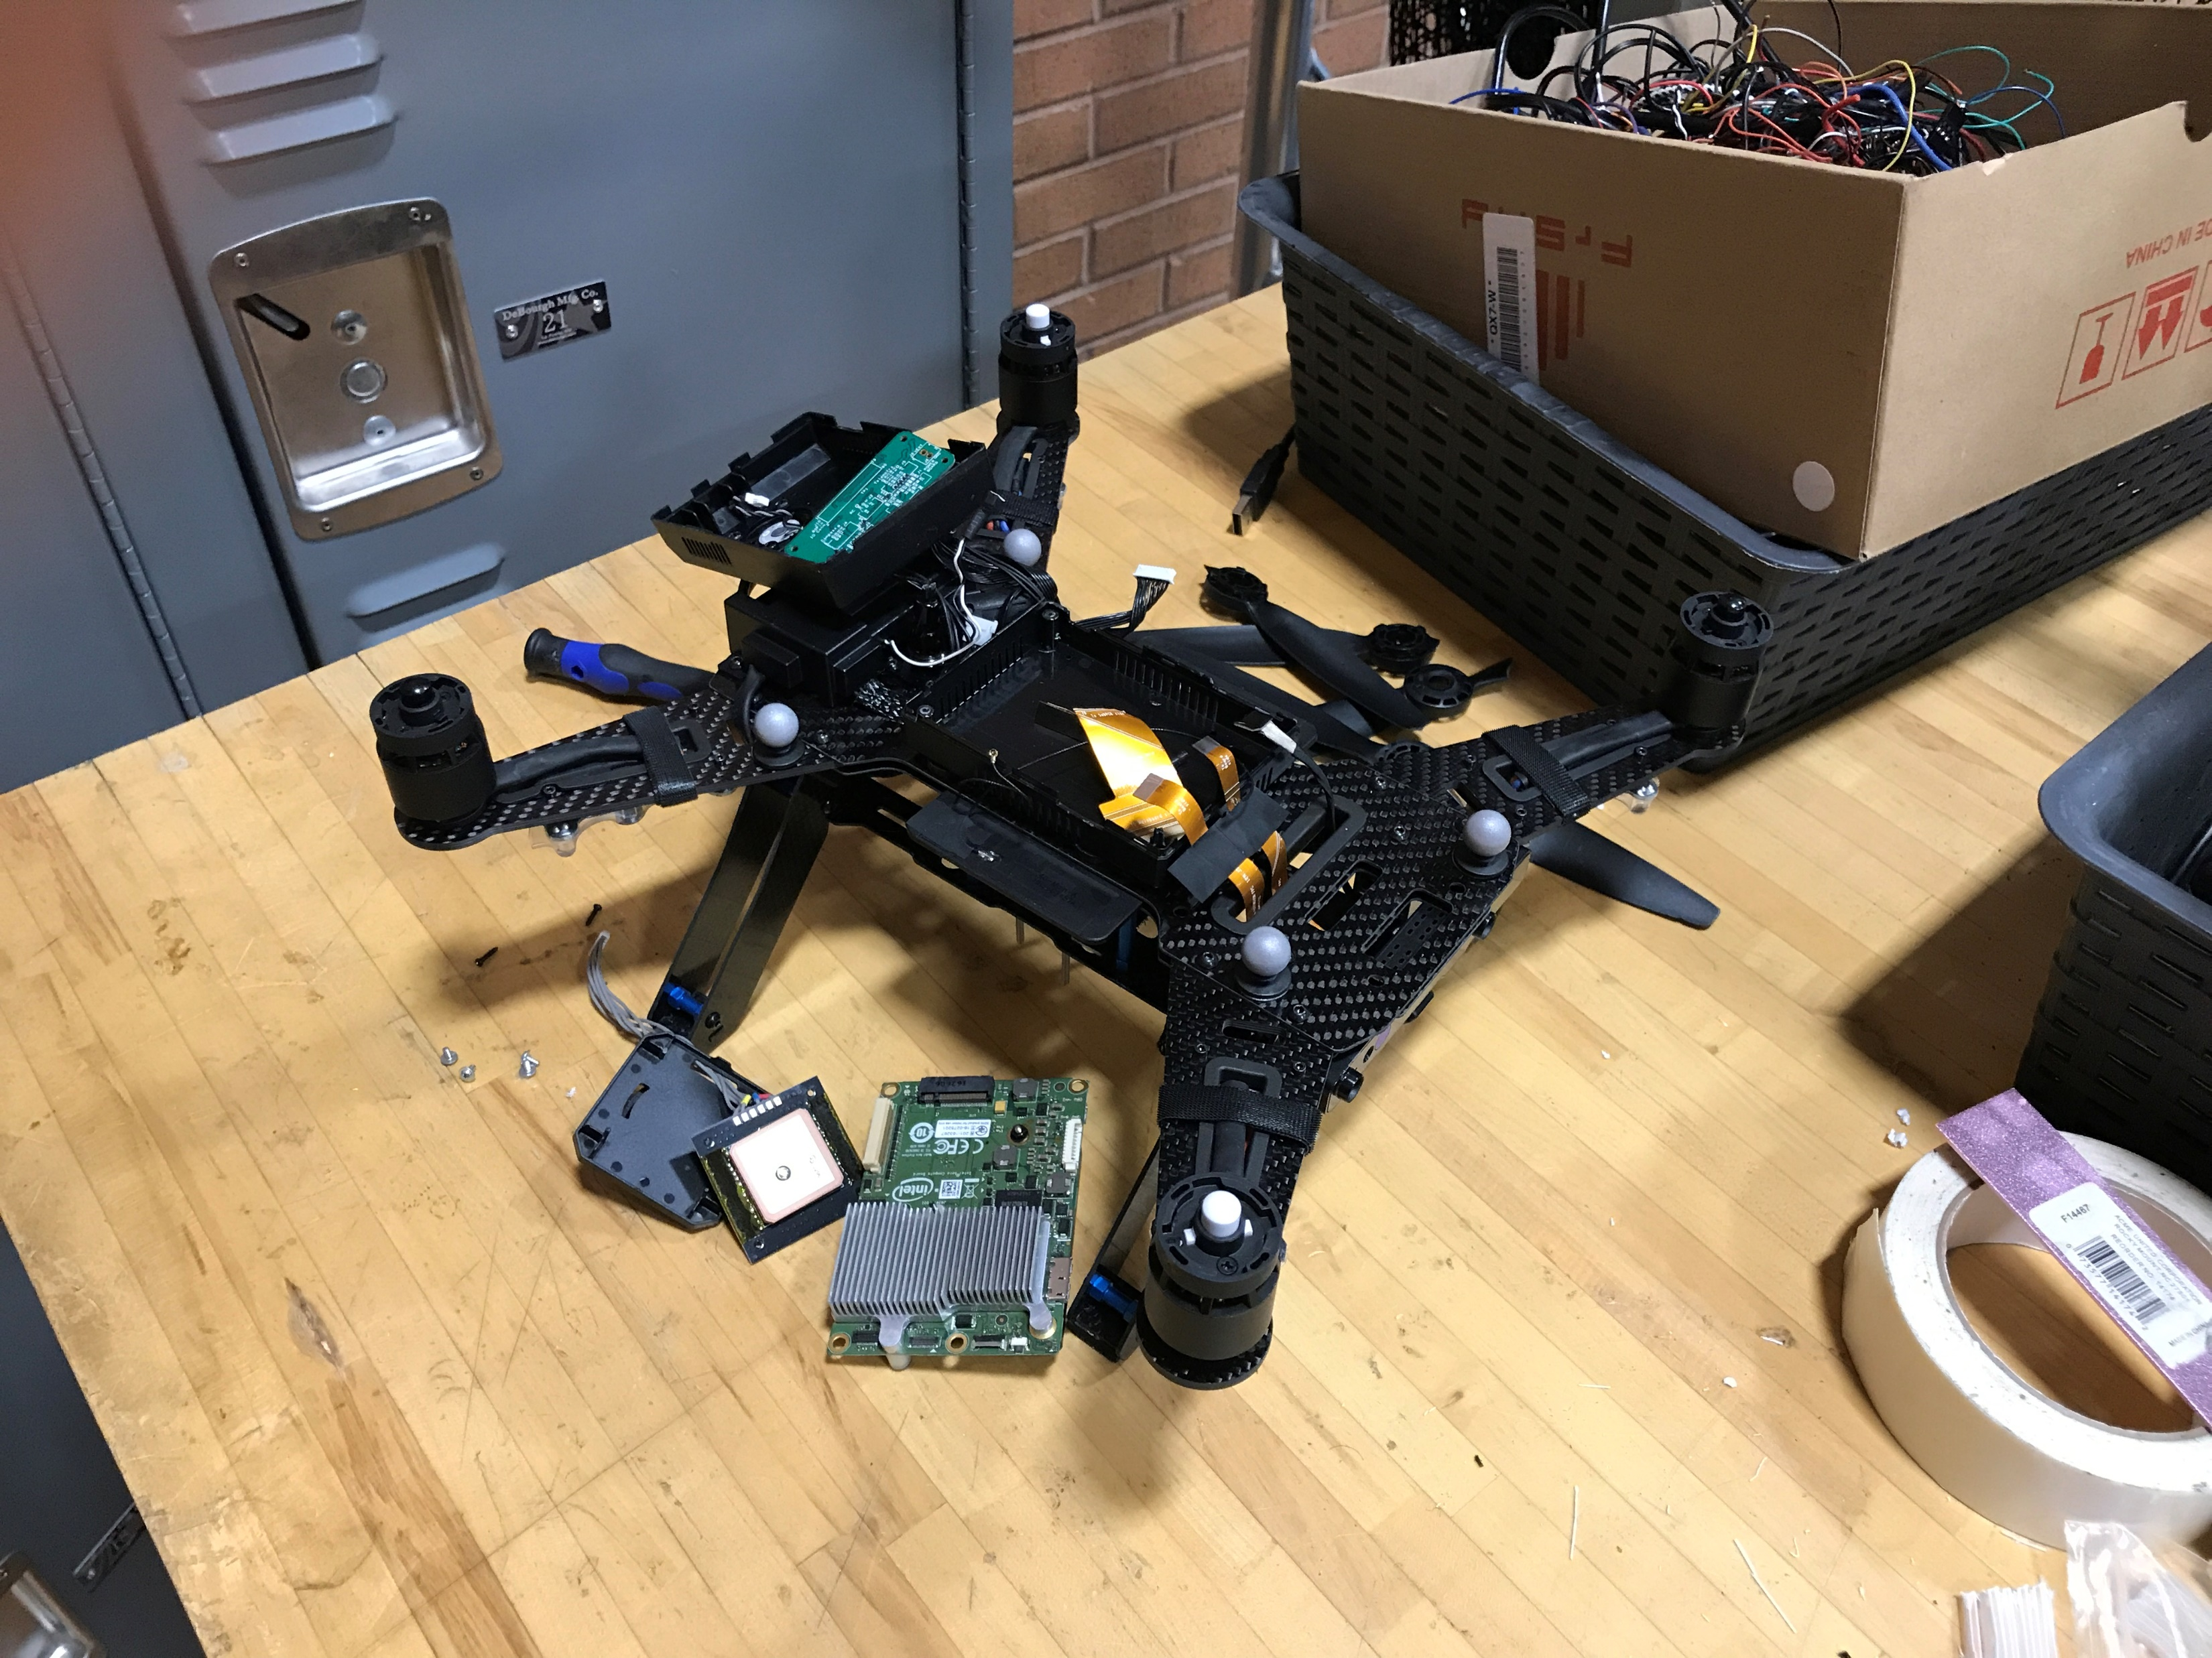
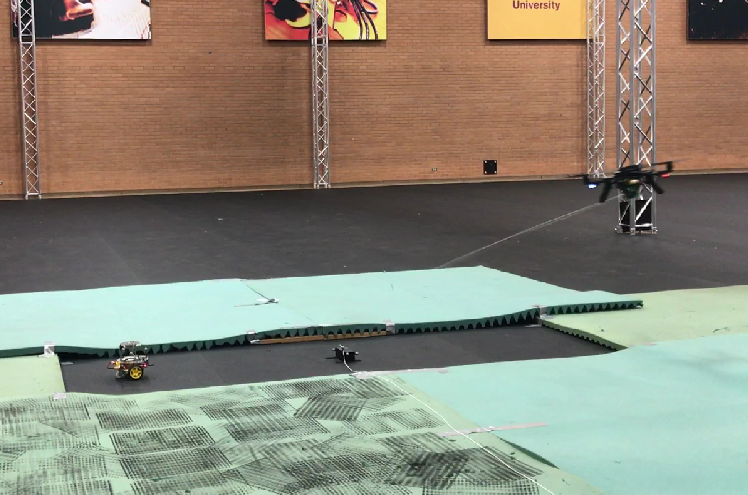
Failures and Failsafes
Incorrect coordinate transformation
Monitor remapped pose topic before running procedure
Magnet does not engage
Coupling mechanism is a sufficient landing pad
Connection loss
Kill switch + Auto land (minimum velocity)
Tracking interference
Sensor fusion
Coupled crash landing
Wheels are unlocked to roll out / prevent toppling
Bad controls
Virtual fence
Speed/acceleration limit
Notes:
That was ultimately a success
Addressed all of the design requirements
Accomplished all of my objectives in the experiment
But I want to talk about some of the failures and how I addressed those
Designed a series of tests building up to the final demo
Starting with just engaging the propellers
Had 1 catastrophic crash and then started designing better test beds
The robots earned their freedom as I replaced physical restraints with better controls

Slide 18
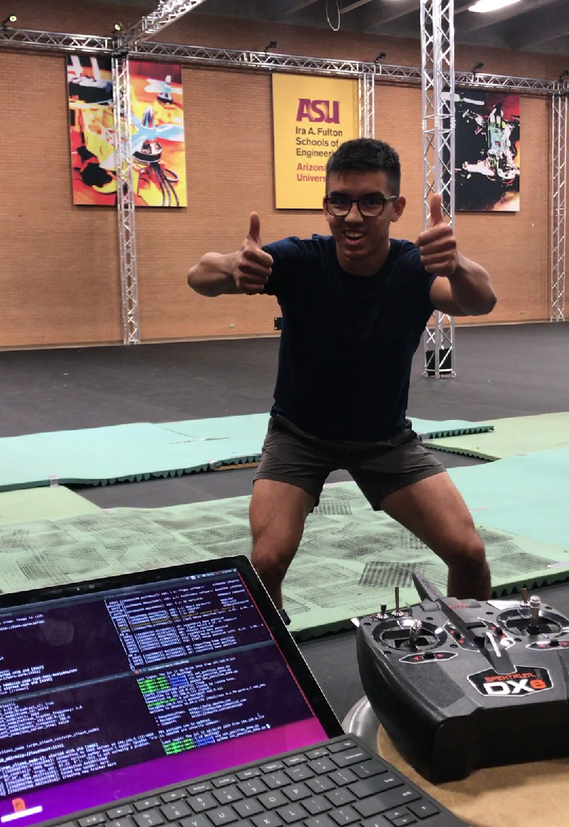
Lessons learned
Consider entire system when designing each part and how they affect each other
Consider all failure modes and design failsafes
Have a systematic procedure for everything with checks along the way
Write it down
I can teach myself how to work outside of my comfort zone
I can hold myself accountable on an independent project

